Slide 1
Batch (BULK) Sample Registration

Slide 2
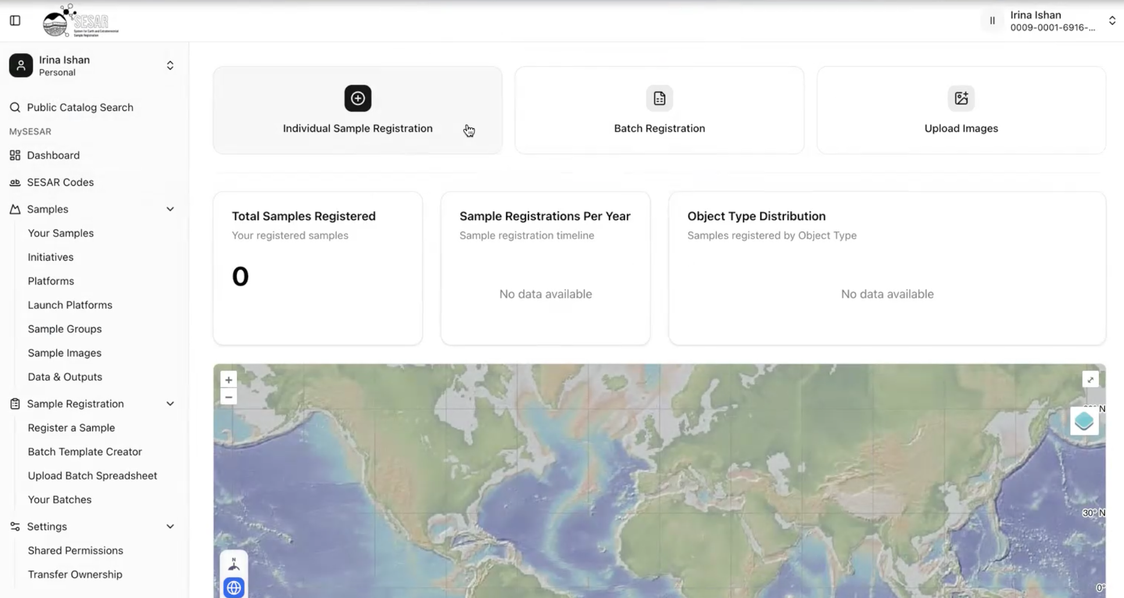
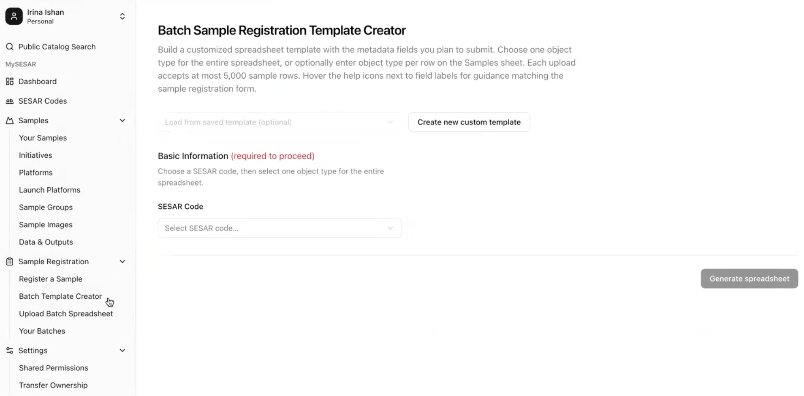
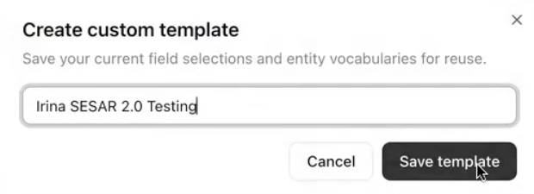
Build a Batch Registration Template
1
Create a Batch Template to begin Batch Registration.
1
Create new custom template and create a unique name for your new template.
1
1
2
2
Choose the SESAR Code you want to build a new template for.
All batch registrations now require use of custom templates for each batch file.

Slide 3
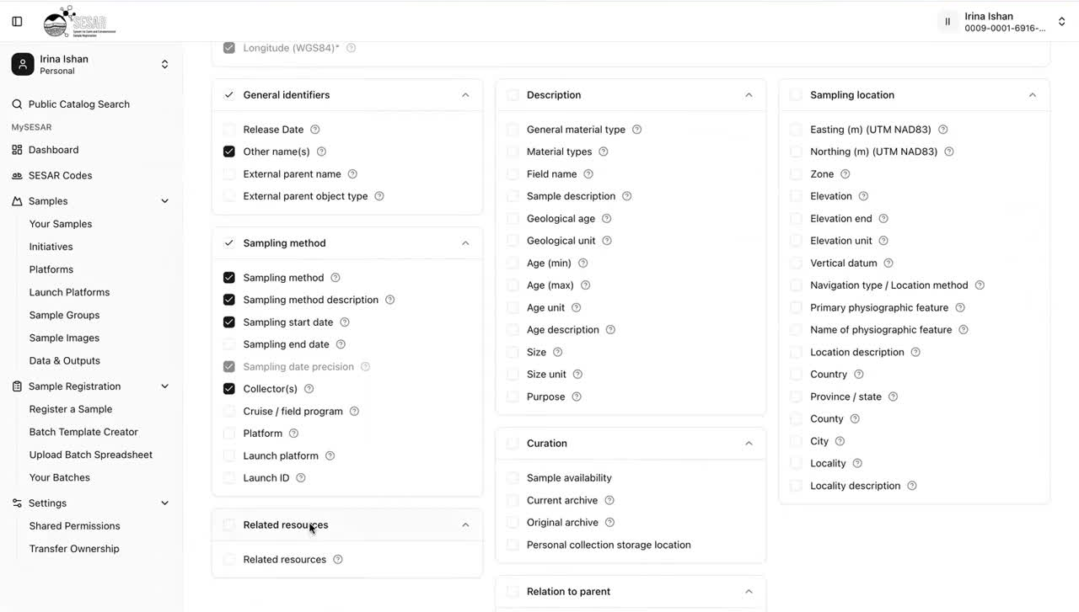
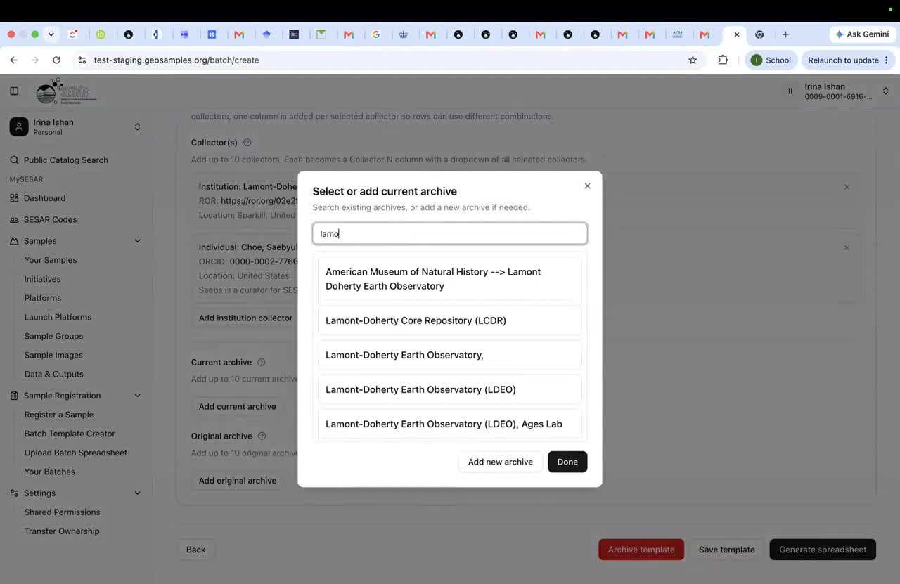
Build a Batch Registration Template
3
4
Select metadata fields to add to your template.
Similar to Individual Registrations, certain fields are required and cannot be edited.
Add Collector(s), Current archive, and Original Archive by clicking ‘Add’.
Add metadata by searching through the name or ORCiD.
If your archive is not listed, click Add New Archive and follow the steps for creating a new value.
Generate spreadsheet for download.

Slide 4
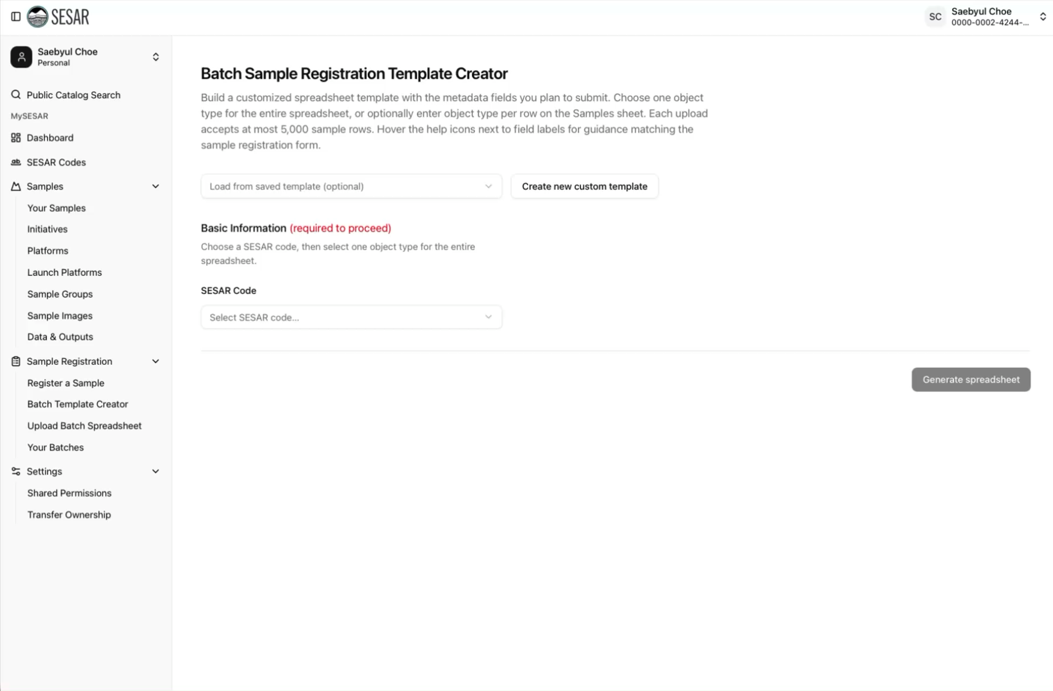
VIDEO Tutorial

Slide 5
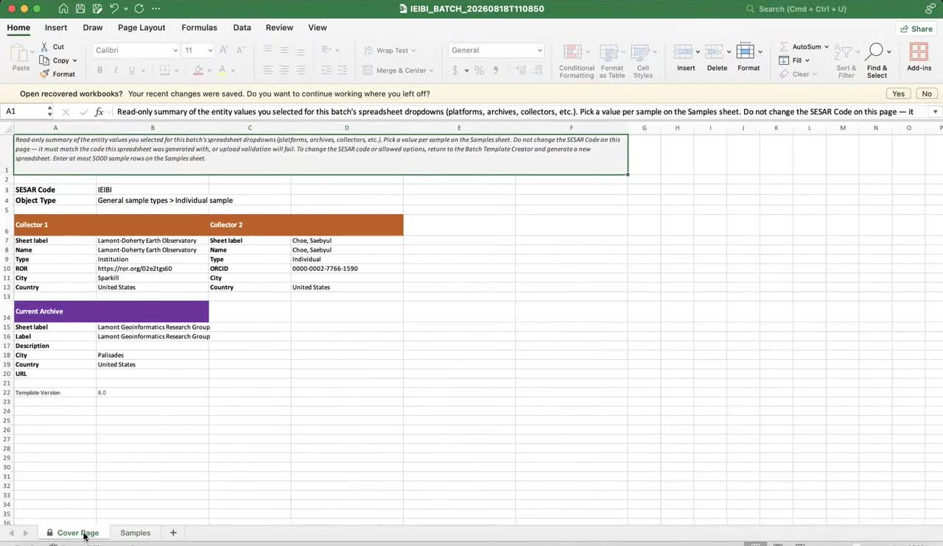
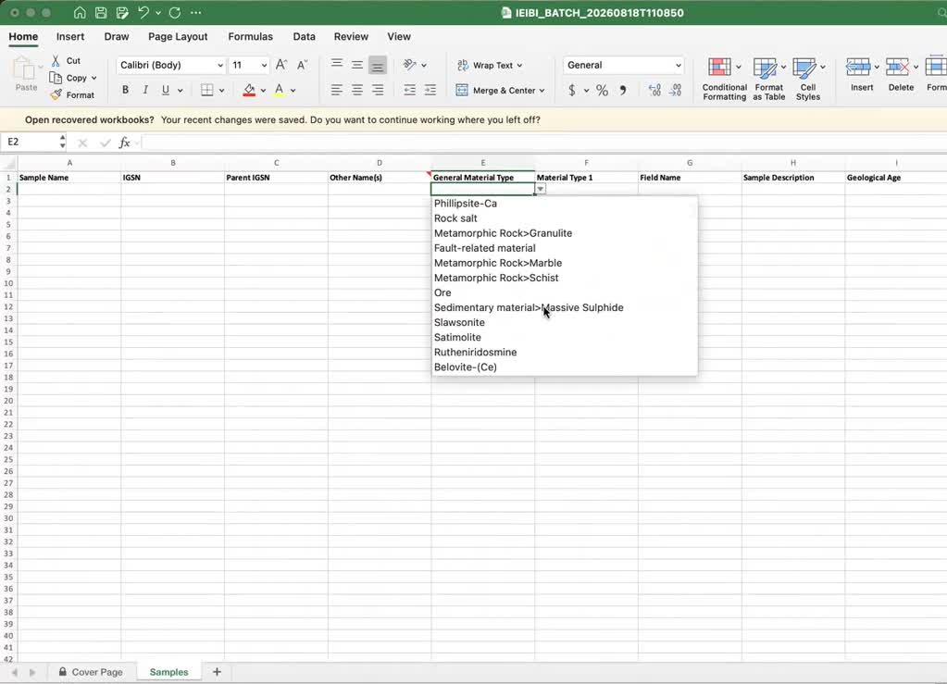
Populate Batch Template
1
2
Keep in mind you cannot edit the Cover Page or controlled vocabularies on the template. Please edit and download a fresh template for each registration.
1
2
Enter metadata in Samples.
Use the pull down list for controlled metadata fields.
Review the template guidance and pre-populated Cover Page before filling rows.
If your cover page is incorrect, edit the saved template and download a new copy.

Slide 6
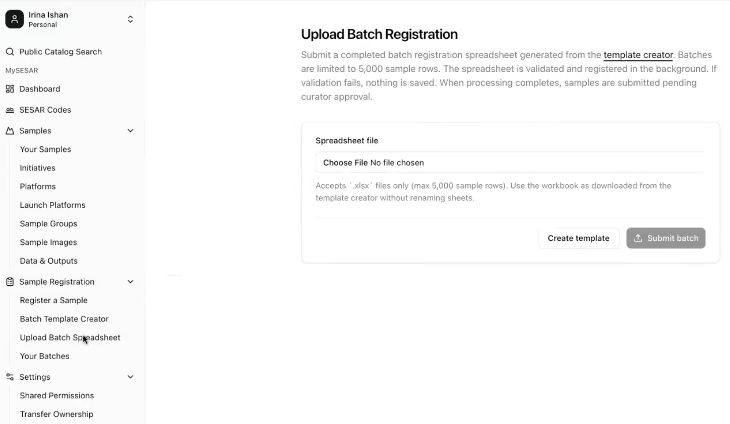
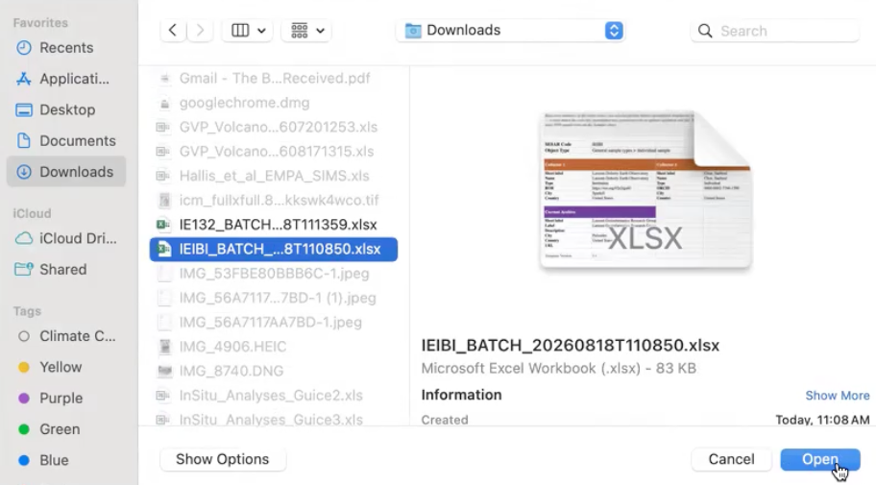
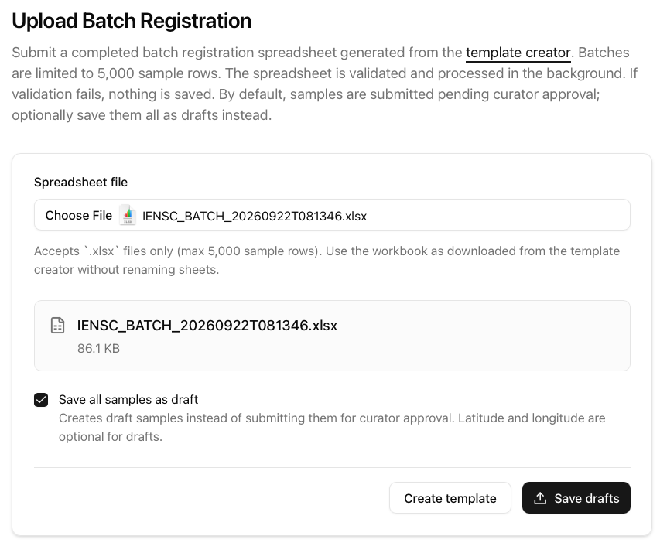
Uploading Batch Template
1
2
Navigate to Upload Batch Spreadsheet
Select Create template (new template) or Choose File.
Add the file you want to upload and Submit Batch.
You can save your samples as Draft if you want to come back to them at a later time.
2
3

Slide 7
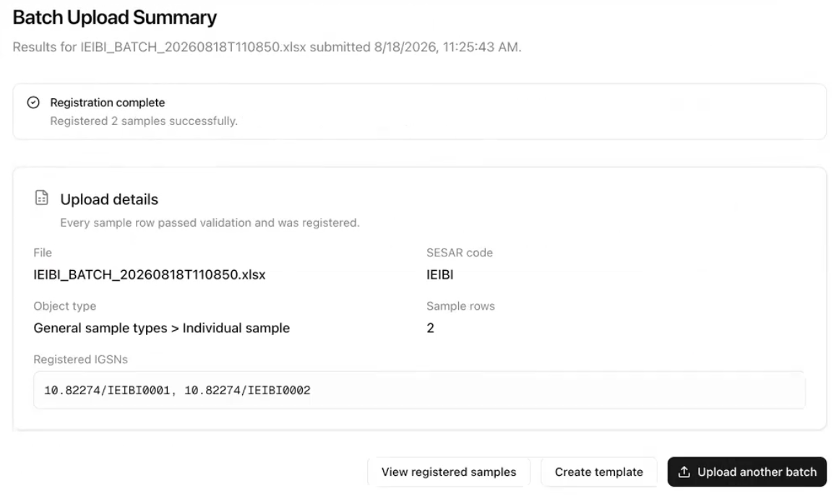
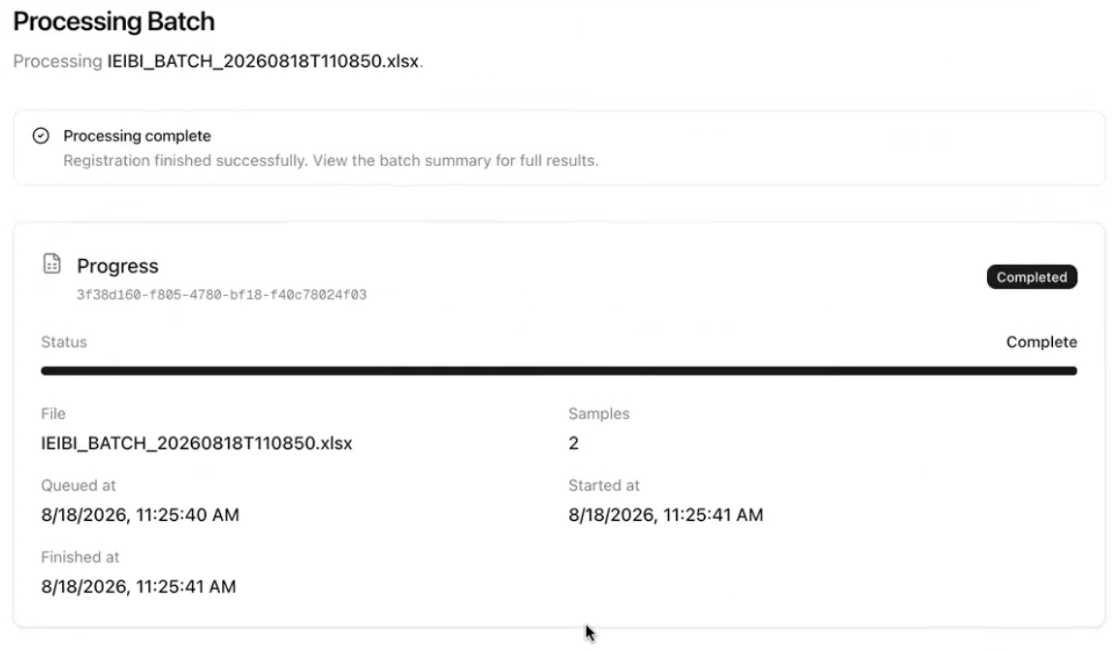
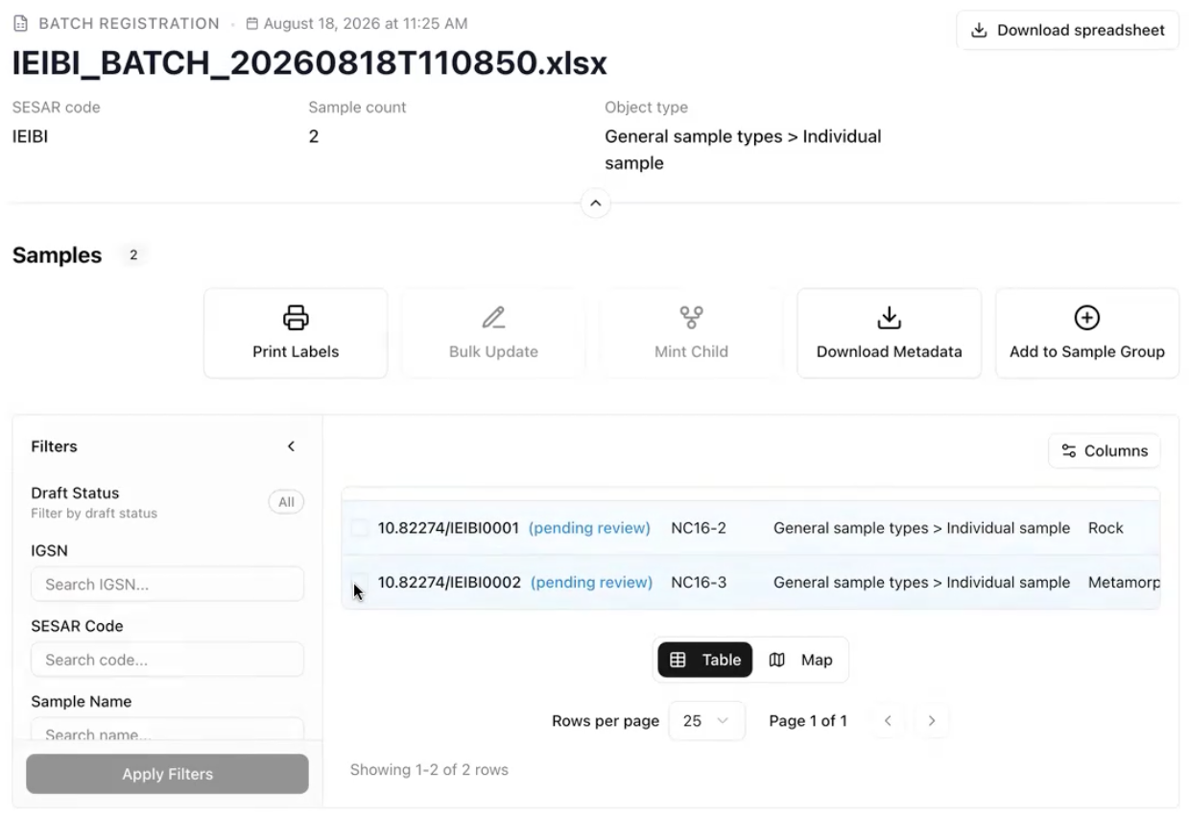
Uploading Batch Template
2
2
Batch Upload Summary displays the batch file, number of samples, and IGSNs assigned to your samples.
Upload a new batch if the information is incorrect or you want to add a new batch submission.
Check your registered samples under View registered samples. This will re-direct you to Your Samples page.
Your samples will have status: pending review until approved by a SESAR curator.
1
Batch upload progress display
2

Slide 8
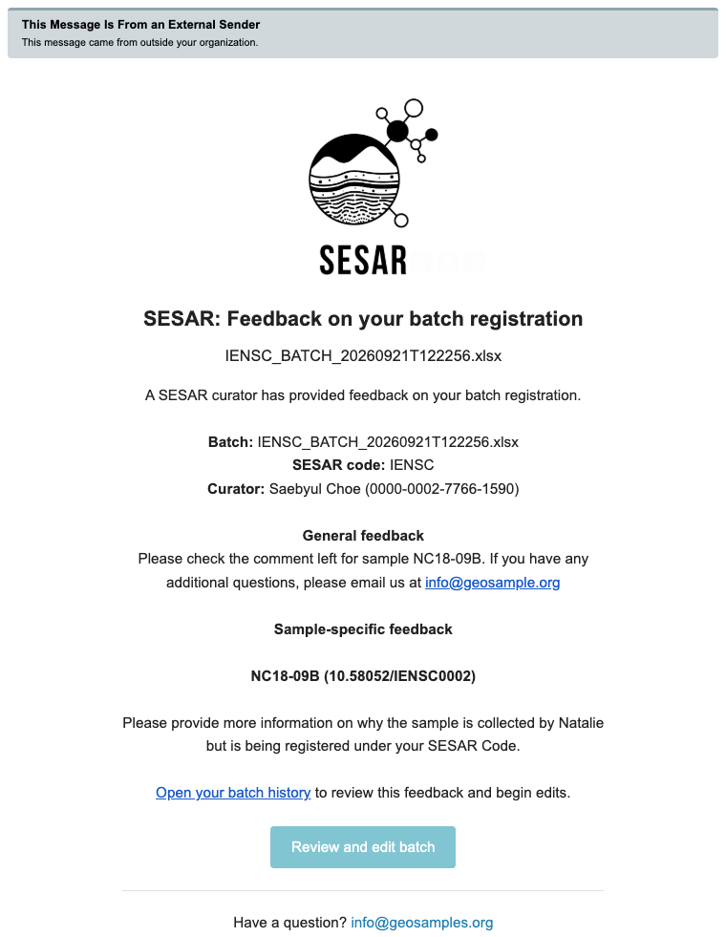
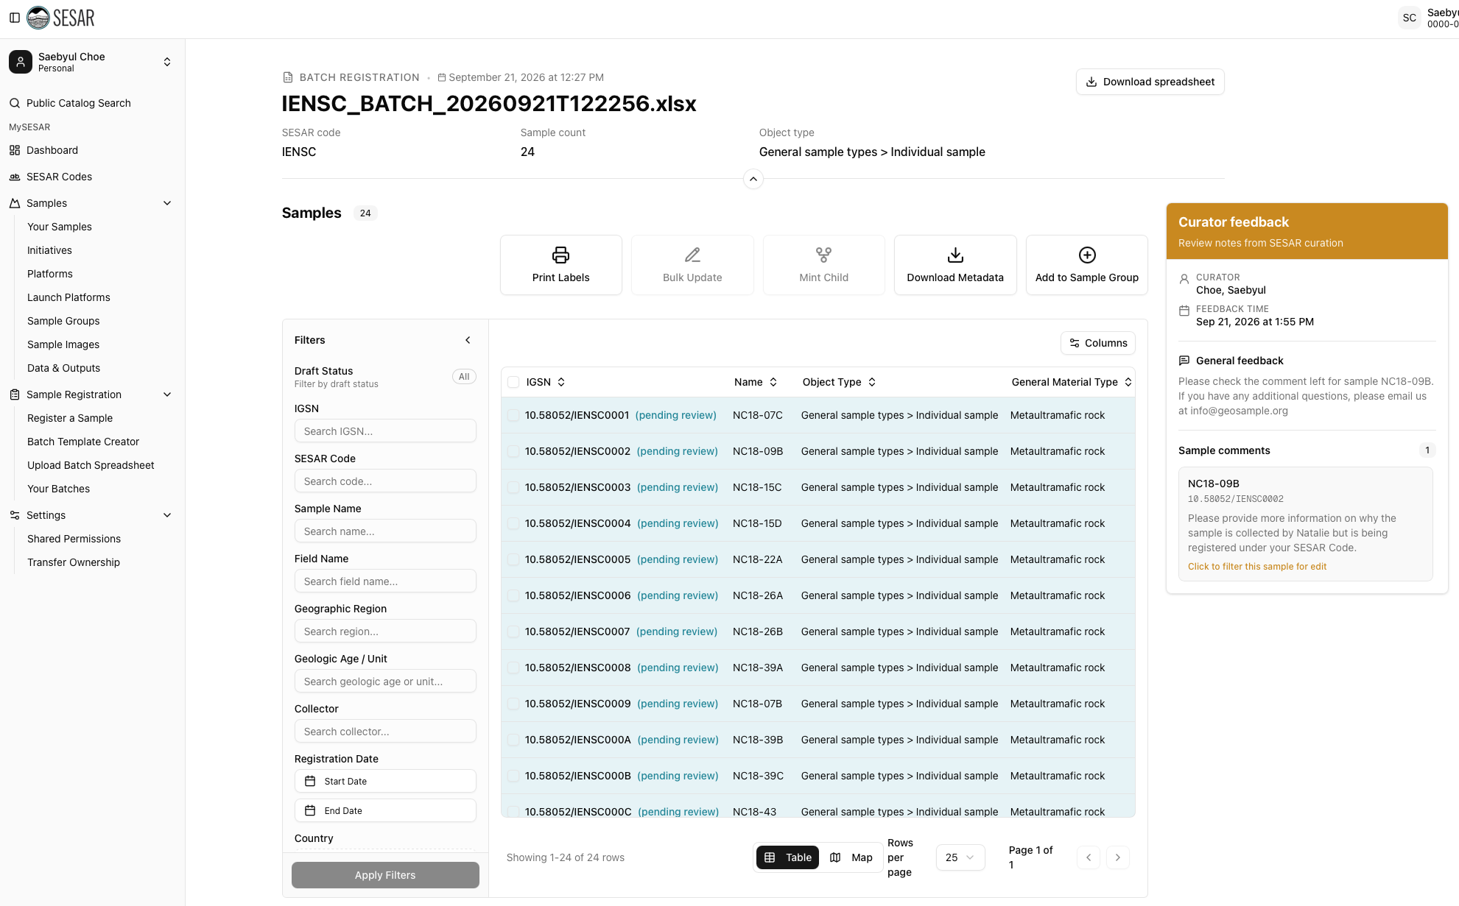
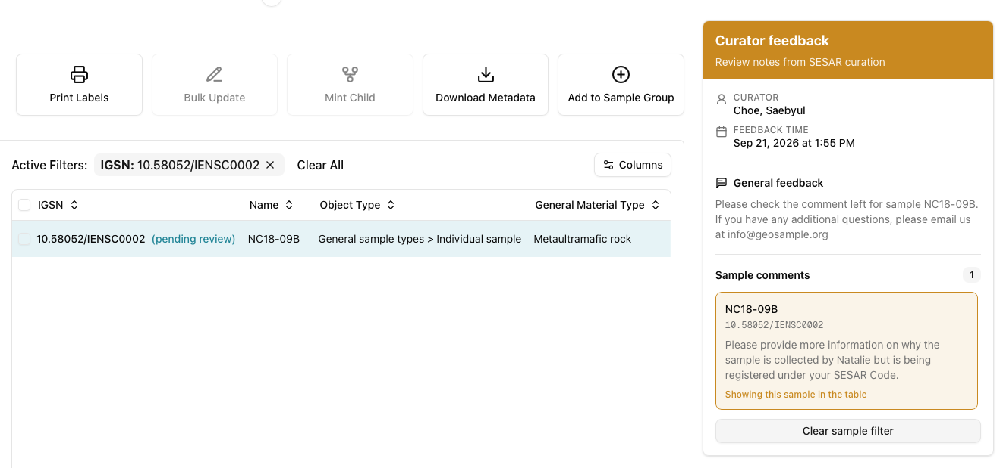
Post Registration
Access your pending batch samples under Your Batches.
Review the Curator feedback. Click to filter this sample for edit will filter and display only the sample with curator feedback.
Email notification from a SESAR Curator will be sent with information on your registration.

Slide 9
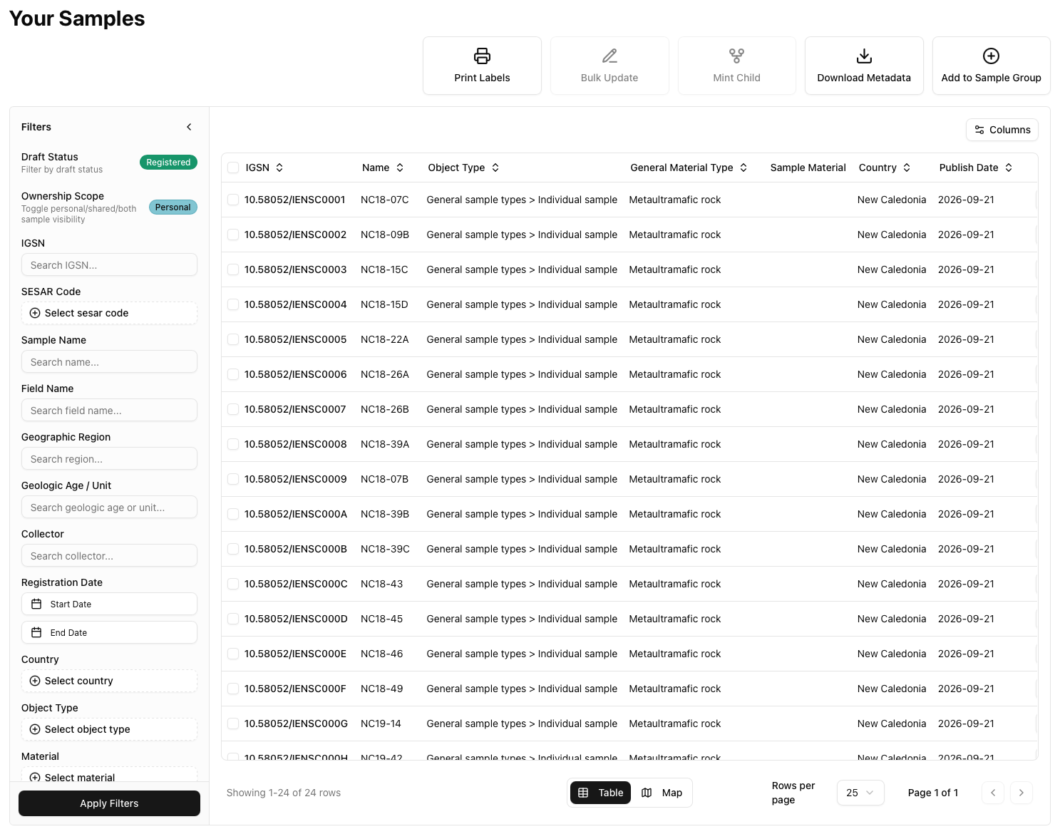
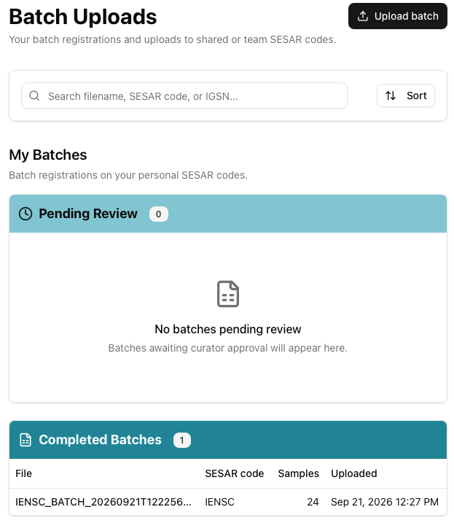
Post Registration
Access your completed batches and status of pending batches in Your Batches.
Approved samples will lose their “pending” status.

Slide 10
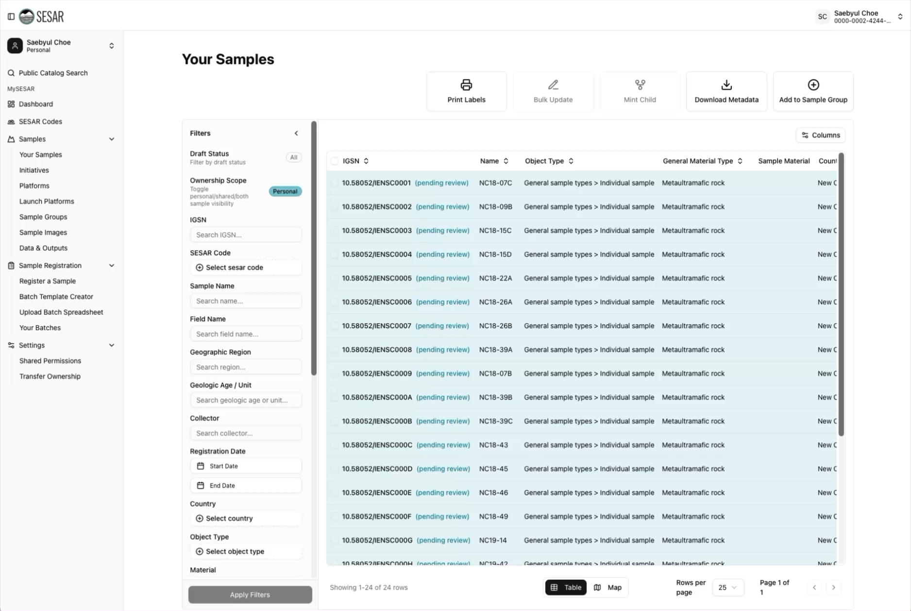
VIDEO Tutorial

Slide 11
Batch Edit (Multiple Samples)

Slide 12
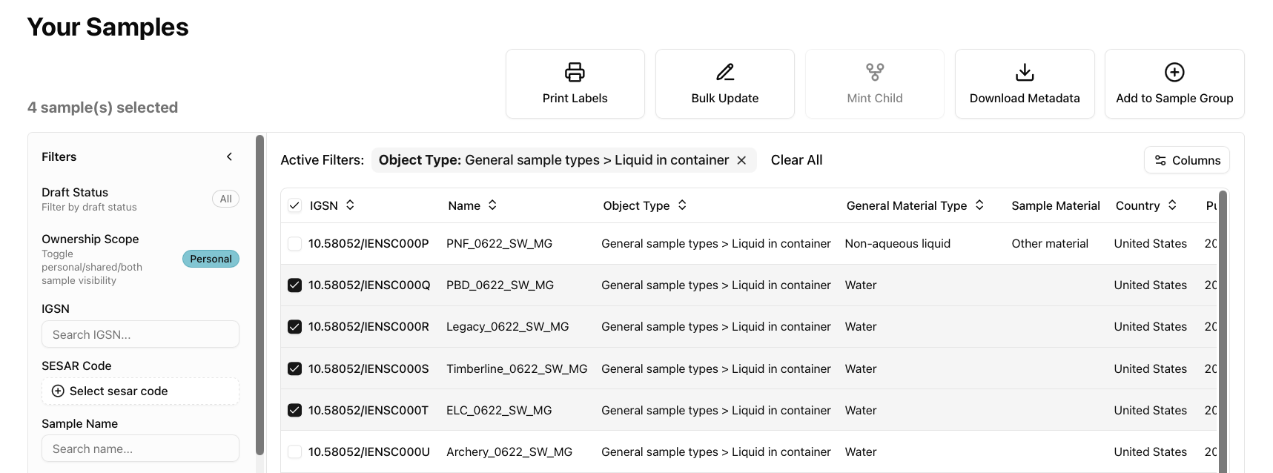
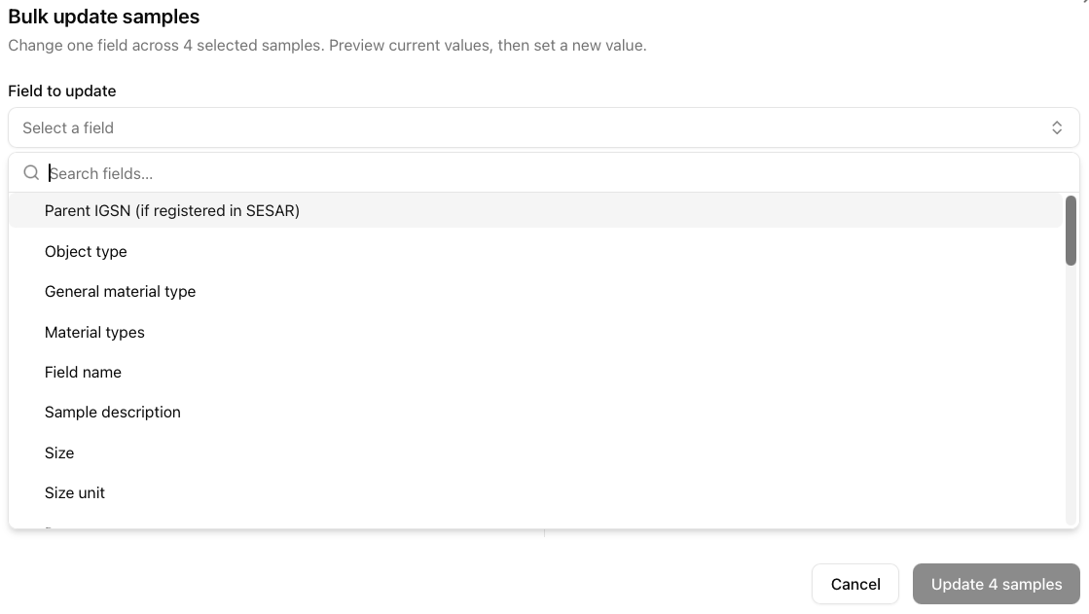
Batch (Bulk) Update
Select the samples you want to batch update.
Click Bulk Update.
Select the Field to update from the drop-down menu.

Slide 13
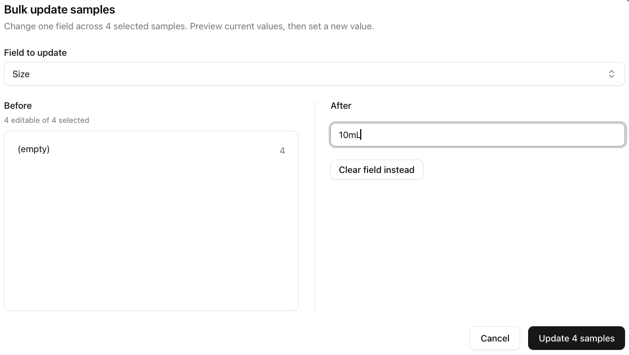
Batch (Bulk) Update
Before shows you the current information that is associated with the sample.
Add content (if free text) or apply controlled vocabulary (drop down) in After.
Once you update the After, click Update X samples.

Slide 14
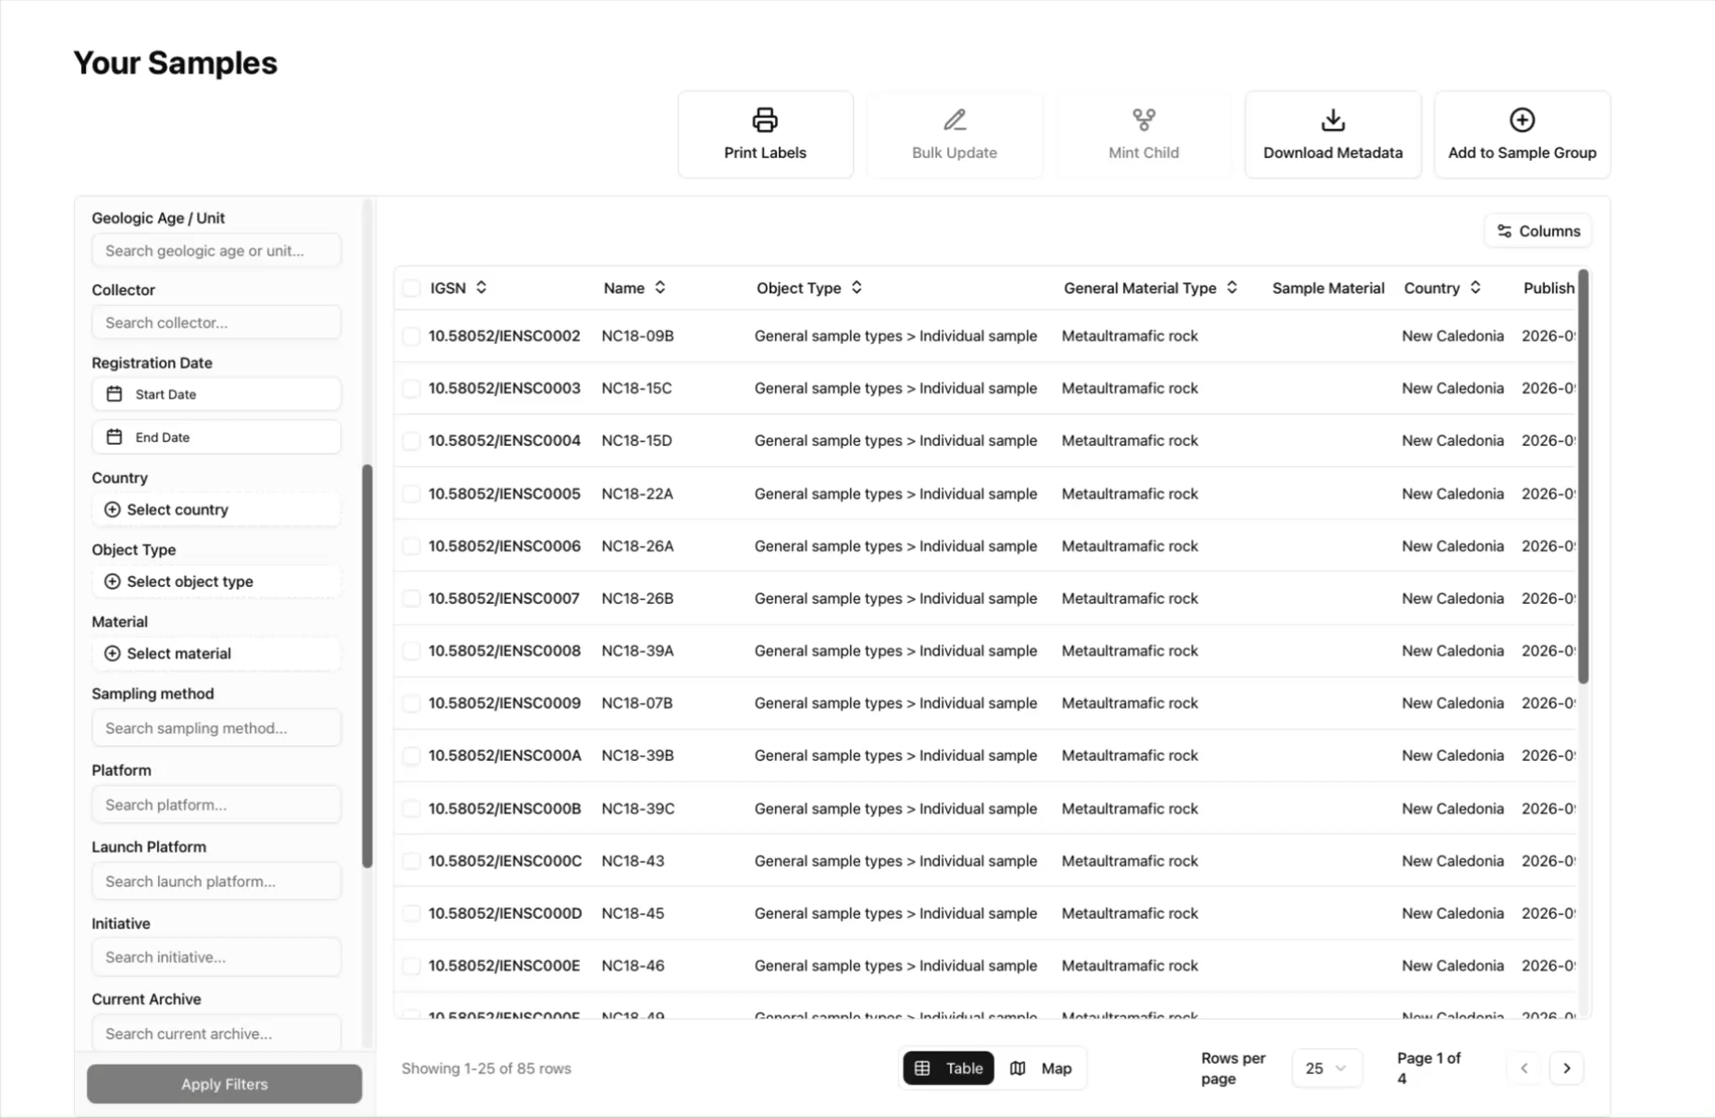
VIDEO Tutorial

